Slide 1



Slide 2
01
Introduction

Slide 3
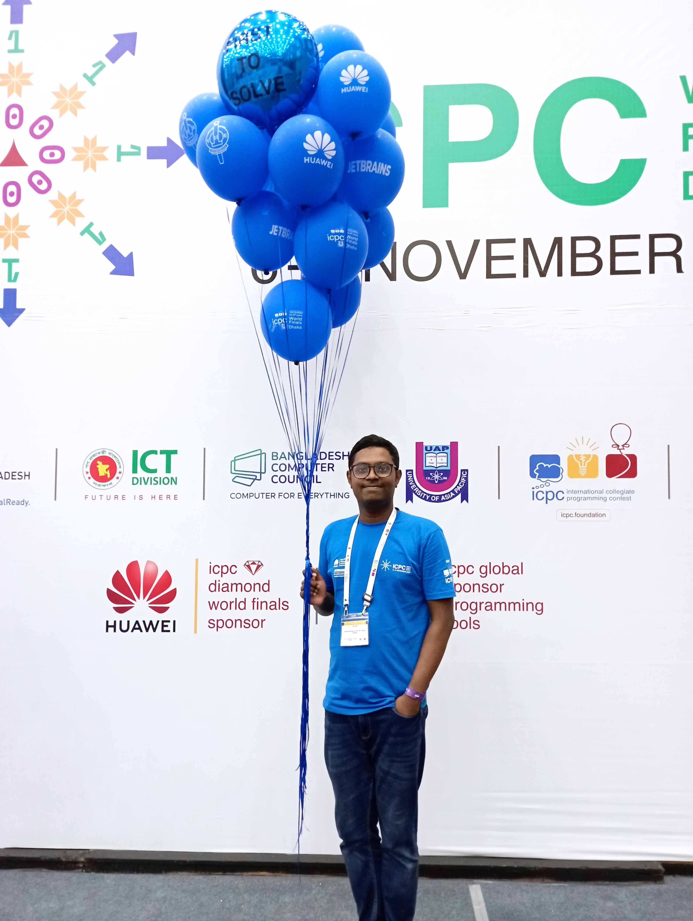

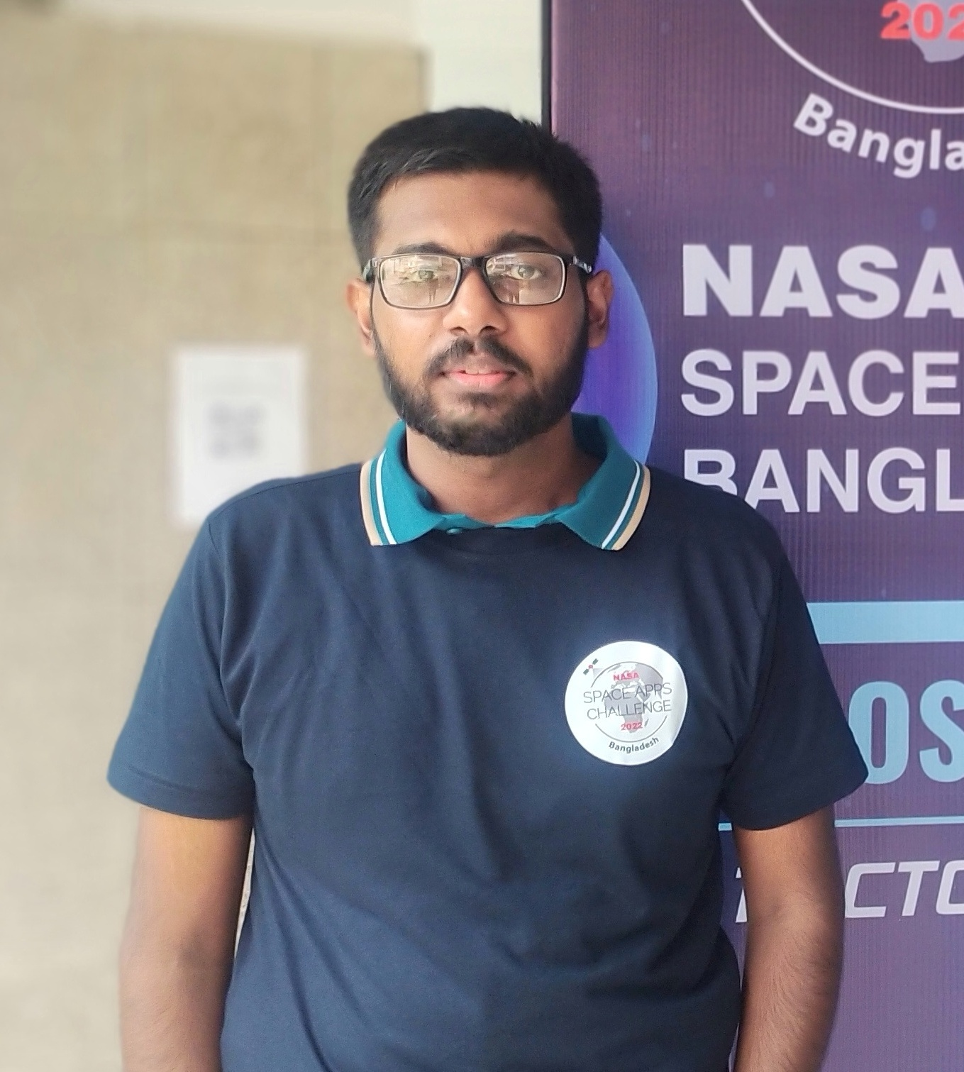
About Us
20101095
Mohammad Enan Al Harun Sahan
20101101
Md. Asadujjaman Noor
20101106
Sheikh Nafez Sadnan

Slide 4

Introduction to Cyber Fusion
Introducing "Cyber Fusion," leading Bangladesh's cybersecurity revolution. With custom solutions and advanced technology, we pioneer remote SOC (security operations center) services, proactively protecting digital assets. Our mission is to create a safer online environment through innovation and quality, positioning Cyber Fusion as the top SOC provider in Bangladesh.
Out motto: “Safeguarding people virtually”.

Slide 5
02
Market Gap

Slide 6
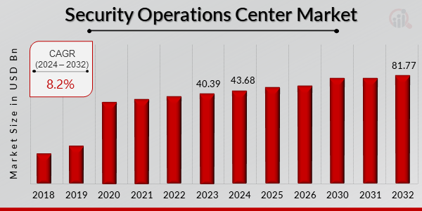
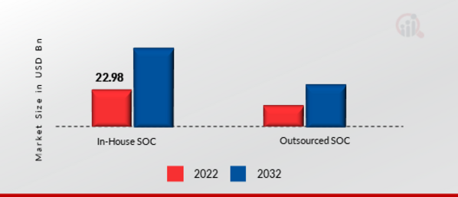
Current Market Gap
The Security Operations Center market industry is projected to grow from USD 43.68 billion in 2024 to USD 81.77 billion by 2032, exhibiting a compound annual growth rate (CAGR) of 8.2% during the forecast period (2024 - 2032).
Growth of different segment of SOC services

Slide 7
03
Product and Service Description

Slide 8
Addressing the market gap
“Cyber Fusion” is the first vendor in the nation to offer remote SOC services, Our service equips businesses with comprehensive solutions, including SIEM, VAPT, PAM, XDR, and EDR, ensuring robust defense strategies. With a commitment to cybersecurity excellence, Cyber Fusion aims to fortify digital defenses across Bangladesh and beyond, fostering a safer online environment through innovation and dedication.

Slide 9


What we do
SIEM (Security Information and Event Management)
VAPT (Vulnerability Analysis and Penetration Testing)

Slide 10

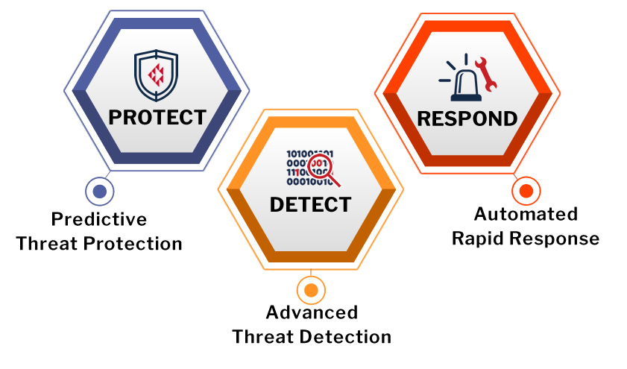
What we do
PAM (Privileged Access Management)
XDR (Extended Detection and Response)

Slide 11
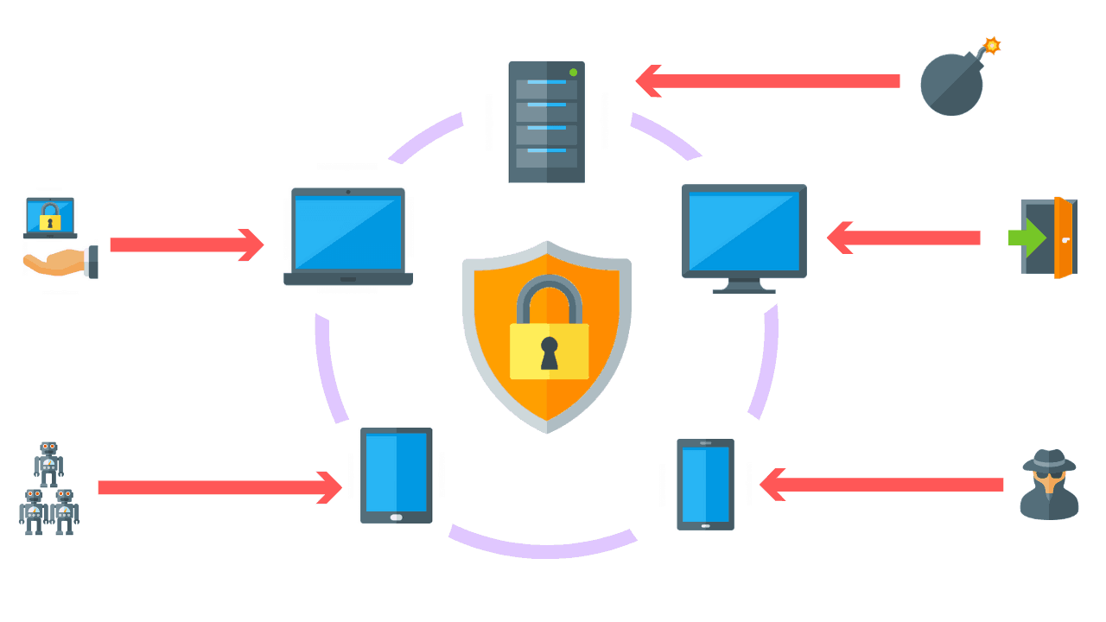
What we do
EDR (Endpoint Detection and Response)

Slide 12
04
Business Model

Slide 13
Subscription based model
Subscription package:
Different tier of subscription package to suit their needs.
Basic
Standard
Premium
Customizable package:
Opportunity customize their cybersecurity solutions.
Additional Services:
Training and awareness campaigns,
Incident response support,
Customized threat intelligence feeds,
On-demand consultancy.

Slide 14
Market and Revenue
 | 2024-25 | 2025-26 | 2027-28 | 2028-29
Market Size (Domestic) | 1 Billion BDT | 2.4 Billion BDT | 7.5 Billion BDT | 12 Billion BDT
Average growth rate | 14% | 21.25% | 6% | 6%
Number of clients | 5,000 | 8,000 | 15,000 | 20,000
Average spending on server security | 200,000 BDT | 300,000 BDT | 500,000 BDT | 600,000 BDT
Market Growth Rate | 6% | 8.7% | 5.50% | 3.33%
Access to remote service | 9% | 15% | 20% | 25%
Clients Able to Use Our Service | 1,250 | 3,500 | 6,000 | 8,000
Clients interested in using our service | 50% | 50% | 50% | 50%
Target Market (Companies) | 75% | 75% | 75% | 75%
Market Penetration (% of Target Market) | 0.5% | 1.5% | 2% | 2.50%
Market Penetration (Taka) | 50 Million BDT | 65 Million BDT | 70 Million BDT | 75 Million BDT
Subscription Cost Average | 85,000 BDT | 90,000 BDT | 95,000 BDT | 100,000 BDT
Average Revenue Per Client | 20,000 BDT | 25,000 BDT | 30,000 BDT | 35,000 BDT

Slide 15
05
Operations Plan

Slide 16
Value Chain Analysis
Core Activities | Inbound Logistics | Operations | Outbound Logistics | Marketing and Sales | After Sales Services
 | Security Agent Deployment Security Configuration Information Threat Intelligence feed Customer Onboarding and Training | Remote Security Service Threat detection, eradication and prevention Creating cyber awareness Enhancing privacy | Security monitoring and alerts Security reports and dashboard Security incident response. | Subscription-based service. Facebook page. Google AdSense. SEO. Offers and discounts. | Feedback collection. Ensuring data privacy. On field training for client employees if necessary.
Support Activities | Infrastructure | One physical office Legal Framework
 | HRM | Recruitment team. Security Agents for training and retaining skilled individuals.
 | Threat Intelligence Gathering | Threat information database. Automated report generation system.
 | Resource Procurement | Smart Technologies | Largest ICT distribution company Bangladesh ICT division

Slide 17
06
Competitor Analysis

Slide 18
Analysis
Direct Competitors | Indirect Competitors | Future Competitors
On site SOC service providers | None | On site SOC service providers
 |  | Remote SOC service providers
 |  | Convenience | Security | Domestic/Foreign | Service Cost | Experience | Recognition
Cyber Fusion |  | Advantage | Even | Domestic/Foreign | Advantage | Disadvantage | Disadvantage
Direct | SOC service providers | Disadvantage | Even | Domestic | Disadvantage | Advantage | Advantage
Overall: Advantageous.

Slide 19
Analysis
Competitors | Service Cost | Availability | Remote service | Coverage | Competitive Advantage
Backdoor.com | High | Work hours + Emergency | N/A | Domestic | Moderate
Hoplonhd.com | High | Work hours + Emergency | N/A | Domestic | Moderate

Slide 20
07
5- Year Revenue and Cost forecast

Slide 21
Fund Raising
 | Month 0 | Month 1 | Month 2 | Month 3 | Month 4 | Month 5 | Month 6 | Month 7 | Month 8 | Month 9 | Month 10 | Month 11 | Month 12
R R & D | Recruitment Cost | Data Collection |  | Server Setup |  |  |  |  |  |  |  |  | Service Launch
 | $20,000 | $5,000 |  | $6,000
Website and Server Development | Recruitment Cost | Structure Development |  |  |  | Employee Training
 | $10,500 | $16,000 |  |  |  | $12,500
Operation | Workspace rent, Hardware purchase, Utility bill, Salary of employees
 | $40,000
Legal | Lawyer | Necessary Registration |  |  | Lawyer Consultation
 | $20,000 | $10,000 |  |  | $10,000

Slide 22
Yearly Revenue and Cost
Item | 2024-25 | 2025-26 | 2026-27 | 2027-28 | 2028-29
Income from User Subscription | $117,000 | $170,000 | $215,000 | $255,000 | $295,000
Net Income | $117,000 | $170,000 | $215,000 | $255,000 | $295,000
Total Expenses
Salaries and Allowances | $63,000 | $67,500 | $71,000 | $75,000 | $79,000
Employee Training Cost | $10,500 | $9,000 | $8,000 | $8,000 | $8,000
Rent, Electricity | $10,000 | $12,000 | $12,000 | $12,000 | $12,000
Website Maintenance Cost | $4,000 | $4,000 | $4,000 | $4,000 | $4,000
Server Management Cost | $8,000 | $13,500 | $13,500 | $14,000 | $14,000
Advertisement Cost | $15,000 | $14,000 | $14,000 | $14,000 | $14,000
Depreciation Cost | $6,000 | $6,000 | $6,000 | $6,000 | $6,000
Interest Expense | $2,000 | $2,450 | $2,650 | $2,850 | $3,050
Total Expenses | $118,500 | $128,450 | $131,150 | $135,850 | $140,050
Total Profit Before Tax | -$1,500 | $41,550 | $83,850 | $119,150 | $154950
Income Tax | $13,800 | $14,900 | $16,800 | $23,300 | $29,760
Net Profit after Tax | -$15,300 | $26,650 | $67,050 | $95,850 | $125,190

Slide 23
08
Marketing Plan

Slide 24
Target-Buyer persona
 | Startup & small business | Medium scale business | High scale business
Spending capacity | Low (less than 20k) | Medium (20k-50k) | High (50k+)
Expectation | Basic and cheap rate subscription | Economically premium service | Premium service
Suitable subscription model | Monthly | Monthly/annual | Annual/customizable
Media | BTL: Social media (facebook, x, youtube etc.). | SEO & SEM, Email promotion | ATL: TV channels, Billboards

Slide 25
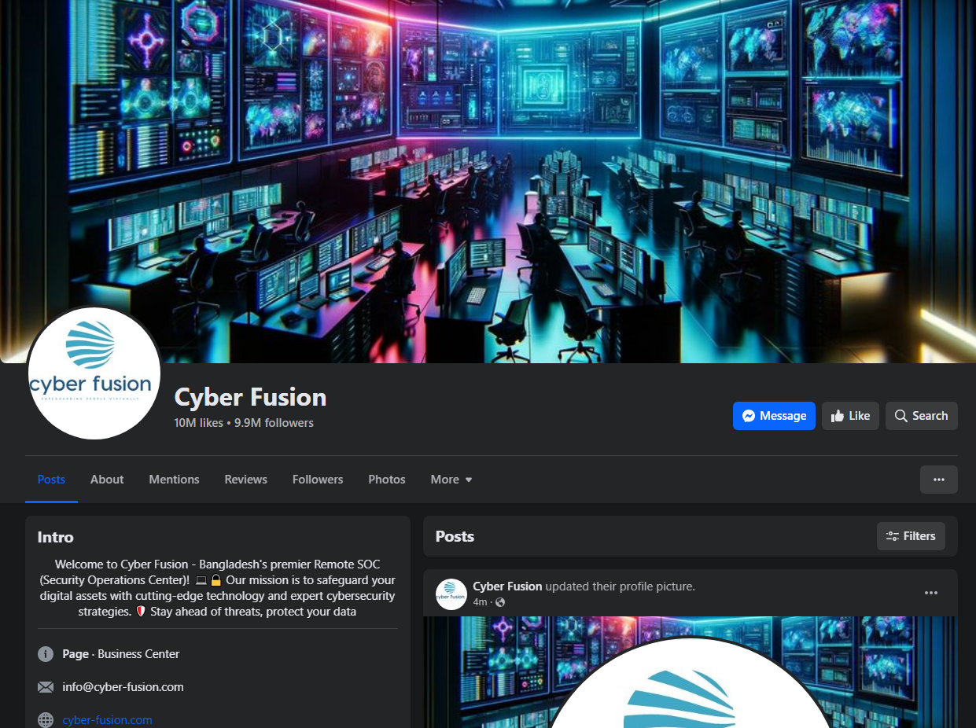
Social media Advertisement and Publicity:

Slide 26
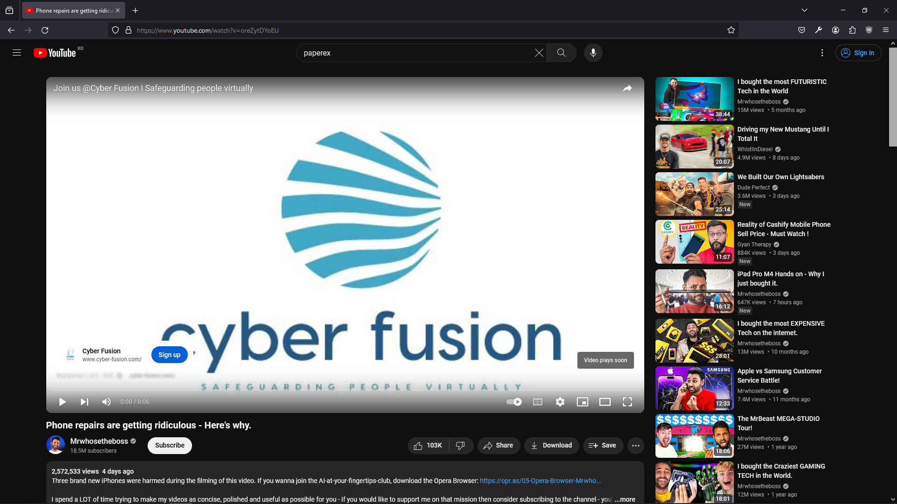
Youtube Advertisement:

Slide 27
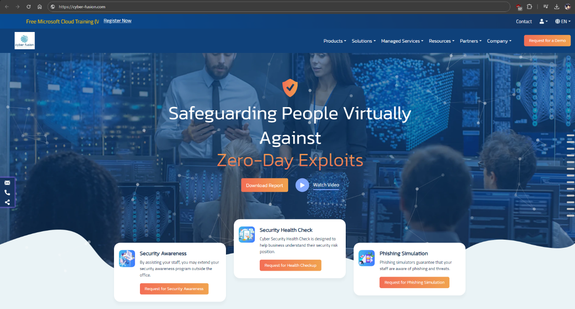
Website:

Slide 28
09
Legal and Regulatory Consideration

Slide 29
Legal Foundations
Step 1 | Online Application
Step 2 | Opening and E-account with RJSC
Step 3 | Preliminary name search
Step 4 | Fee payment
Step 5 | Money receipt submission
Step 6 | Obtaining name clearance certificate
Stamp duty payment
Payment of Stamp Duty is made to The Treasury of Sonali Bank | Costs: BDT 3,000 for Article of Association + BDT 50 for Certified Copy BDT 1,000 for Memorandum of Association + BDT 50 for Certified Copy

Slide 30
Register and RJSC
Basis: Companies Act 1994
Step 1: Preparing MOA and AOA as appropriate to the entity type
Step 2: Apply for company registration
Step 3: Filling in Name Clearance Submission number and letter number
Step 4: Filling in the prescribed forms
Step 5: Attaching the MOA and AOA
Step 6: Submitting the Registration Application
Step 7: Depositing the required fee
Step 8: Uploading document in online
Step 9: Printing the uploaded documents and Submitting those documents
Step 10: Receiving a Certificate of Incorporation

Slide 31
Required Documents
Required Documents
1. Name clearance certificate
2. Memorandum and Articles of association
3. Filled in Form I: Declaration on Registration of Company
4. Filled in Form VI: Notice of Situation of Registered Office and of Any Change therein
5. Consent of Director to act
6. List of Persons Consenting to be Directors
7. Particulars of the Directors, Manager and Managing Agents
8. Proof of payment for Treasury Stamps
9. TIN Certificate of all Directors
Make Company Seal | Open a Bank Account

Slide 32
Obtaining Trade License
Basis: City Corporation Ordinance, 1983
Step 1: Collect prescribed Application
Step 2: Submit completed Application Form with supporting documents
Step 3: Inspection by the Licensing Supervisor
Step 4: Deposit required fees
Step 5: Obtain Trade License

Slide 33
Required Documents
Required Documents
1. Application Form
2. National ID Card of the Entrepreneur
3. Holding Tax Payment receipt
4. Recent Passport Size Picture of the Entrepreneur
5. Declaration of non –Judicial stamp to abide by the rules & regulation of City Corporation & Municipal Corporation
6. A certified copy of the memorandum and articles of association
7. A copy of the certificate of incorporation
8. Agreement of Partnership
9. Tax Identification Number certificate
10. A copy of the lease agreement of the registered office
11. Work Permit from Bangladesh Investment Development Authority
12. Statement of Bank Solvency

Slide 34
Obtaining TIN certificate
VAT registration
Basis: Value Added Tax Act 1991
Step 1: Collecting prescribed application
Step 2: Submitting filled in application form with supporting document
Step 3: Verifying the documents by NBR officials
Step 4: Physical inspection of the business premises
Step 5: Obtaining a VAT Registration Certificate

Slide 35
Register with BIDA
Basis: Investment Board Act 1989
Step 1: Collect a local investment registration form
Step 2: Deposit the Registration fee
Step 3: collect a pay order/bank order
Step 4: Submit the completed application form
Step 4: review of the application and documents
Step 5: Obtain Registration Certificate
Required Documents
1. Application in duly filled in prescribed form
2. Trade License
3. Certificate of Incorporation along with Memorandum of Association (MOA)
4. Deeds of the proposed land
5. Background of the proprietors in officials letter head pad
6. Pay Order/Bank Order for applicable registration fee in favor of Bangladesh Investment Development Authority
7. TIN Certificate

Slide 36
Legal Foundation
Department of ICT | Established rules and regulations to follow for an IT business.
ICT act 2006 | Provisions related to data security and privacy.
Digital Security Act 2018 | Rules to follow before using and spreading information.

Slide 37
10
Initial chart of investment required

Slide 38
FFnFs
 | Profile 1 | Profile 2 | Profile 3
Name | MD. Sultan Ahmed | Nadim Ahmed | Labib Ahmed
Occupation | Businessmen | Businessmen | Service Holder
Relation with the Co-founder | Father | Brother | Brother
Investment Amount | $30,000 | $50,000 | $25,000
Investment type (Debt or Equity) | Debt | Equity | Equity
Conditions (Any) | - | - | -
Interest | Variable Interest Rate (Inflation + 2%) | - | -
Stock | - | 7% | 3%
BOD | - | - | 1 Seat
BOA | - | - | -

Slide 39
Fund requirement and investment
Investment:
Requirement:
Purpose of fund | Amount
Physical Office | $35,000
Company Registration | $15,000
Advertisement and Promotion | $15,000
Additional space for equipment cost | $20,000
Hardware and Software | $20,000
Personnel | $15,000
Training Cost | $5,000
On field personnel cost | $5,000
External deals | $10,000
Interest payment | $10,000
Year | Yearly
2024-25 | $150,000
2025-26 | $200,000
2026-27 | $0
2027-28 | $90,000
2028-29 | $0

Slide 40



Thanks!

